Slide 1
PROJECT TITLE: Web Based Time and Productivity Analysis
PIP104 PROFESSIONAL PRACTICE-II
VIVA-VOCE
Batch Number:
Roll Number | Student Name
20201CSE0787 | ASHA S
20201CSE0812 | VAISHNAVI R
20201CSE0815 | ROSELINE C
Under the Supervision of,
MS.SREELATHA P.K
Assistant Professor
School of Computer Science Engineering Presidency University

Slide 2
Abstract
Effective management of time in project execution and success.
Resources allocation
Identifying bottlenecks
Optimizing time allocation
Emphasizing the dynamic nature of the interplay between time management and productivity across diverse domains.

Slide 3
Introduction
A project management system is a comprehensive framework designed to facilitate the planning, execution, monitoring, and completion of projects within an organization.
It encompasses a set of tools, processes, and methodologies aimed at Task Tracking and Management, Documentation and Reporting of Projects, and effective selection of project managers and employees for the organization with user Authentication.
The primary goals of a project management system include enhancing project efficiency, minimizing risks, and delivering successful outcomes within defined timelines.

Slide 4
Literature Review
The challenge at hand revolves around the absence of a unified and user-friendly system for monitoring and analyzing the allocation of resources' time within organizations.
Organizations grapple with optimizing resource allocation and productivity due to the dearth of actionable insights into resource activities, making well-informed decisions challenging.
The absence of a centralized system hinders businesses from identifying time-wasting activities, understanding where resources are most effective, and pinpointing workflow bottlenecks.
Our project aims to develop a web-based software tool that meticulously records and categorizes the time spent on various activities. This information will be stored in a centralized database, addressing the challenges mentioned..

Slide 5
Research Gaps Identified
Cell NO | TITLE | OBJECTIVE | ADVANTAGE | DISADVANTAGE | YEAR
1 | TIME MANAGEMENT PERCEPTION IN SOFTWARE TEAMS | IMPROVE THE ACCURACY OF TIME ESTIMATES FOR PROJECT TASKS | OPTIMISE RESOURCE ALLOCATION | PRESSURE FOR UNREALISTIC PRECISION | 2018
2 | OPTIMIZATION AND TIME MANAGEMENT FOR WEEKLY CLASS SCHEDULE | PRIORITIZATION AND TASK MANEGEMENT | FLEXIBILITY ADAPTABILITY | CONSUME TIME TO ADAPT | 2022
3 | TIME MANAGEMENT BASED PREDICTION FOR QUALITY CRITERIA IN PRODUCTION PROCESS | ENABLES IN MONITORING AND FEEDBACK | ENHANCED PRODUCT QUALITY | REQUIRE SIGNIFICANT INVESTMENT | 2023

Slide 6
Research Gaps Identified
Cell NO | TITLE | OBJECTIVE | ADVANTAGE | DISADVANTAGE | YEAR
4 | TIME MANEGEMENT IN SOFTWARE DEVELOPMENT | ANALYSE THE IMPACT OF PROJECT MANEGENMENT IN SOFTWARE PROJECT | PROVIDES LEVEL OF PRECISION IN TIME | COMPLEXITY DEPENDENCY | 2023
5 | IMPROVED TIME MANAGEMENT IN TRACKERS OF LARGE COLLABRATIVE PROJECTS | USER TO SEARCH FOR MISSIING DEPENDENCIES AND DUPLICATE ISSUES | IMPROVED UNDERSSTANDING IDENTIFICATION OF DEPENDENCIES | LIMITED VIEW INCONSISTENCE EXPLICT DEPENDENCIES | 2023
6 | PROJECT MANEGEMENT IN REQUIREMENTS ENGINEERING FOR GLOBAL SOFTWARE DEVELOPMENT | INVESTIGATE THE EFFECT OF PROJECT REQUIREMENTS, AND PROPOSE A FRAMEWORK . | IMPROVED COMMUNICATION INCREASED EFFECTIVES OF SOFTWARE | POORLY DEFINED, INADEQUATE COMMUNICATION, LACK OF DOCUMENTATION | 2018

Slide 7
Proposed Methodology
Effective web-based time productivity analysis involves the use of various methods and tools to ensure that tasks are completed on time and within the allocated resources.
Work breakdown structure
Agile methodology
Gantt chart

Slide 8
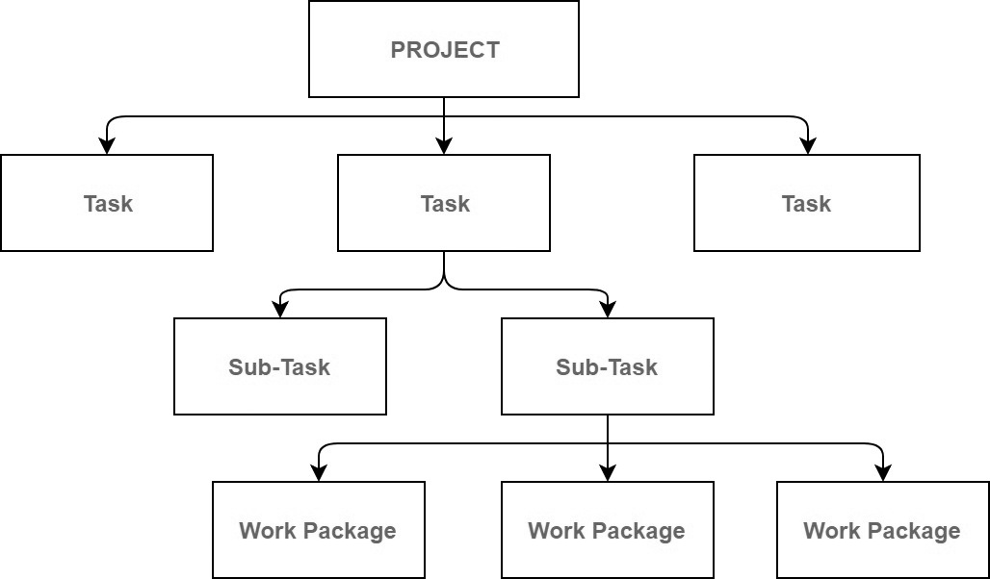
Work breakdown structure

Slide 9
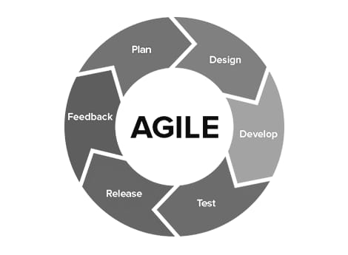
Agile methodology

Slide 10
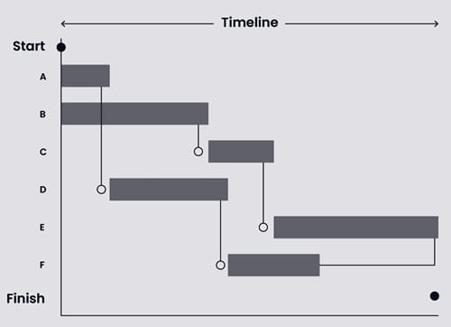
Gantt chart

Slide 11
Objectives
Task Tracking and Management
Documentation and Reporting
Adaptability
Change Management
Project Visualization
Task Ownership and Responsibility

Slide 12
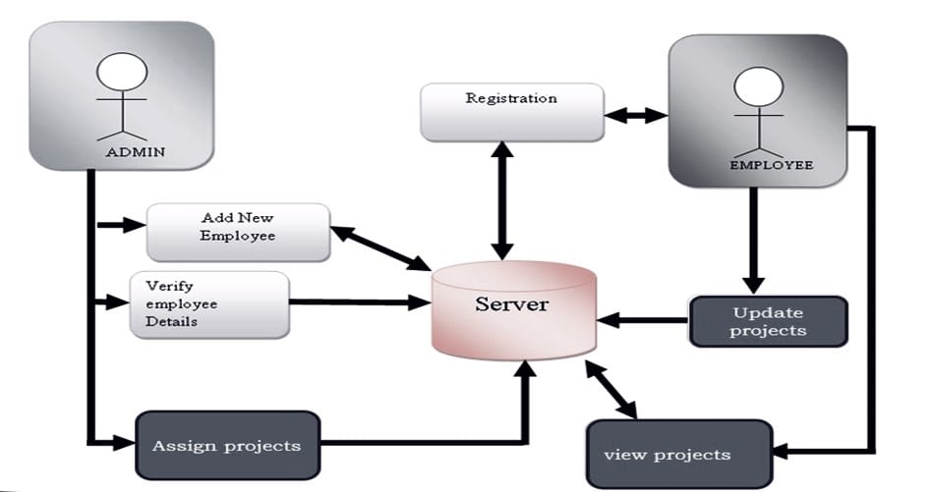
System Design & Implementation

Slide 13
Timeline of Project

Slide 14
Outcomes / Results Obtained
User Registration and Authentication.
Task Management.
Task Listing and Sorting
Document and Information Management
Accurate Planning and Scheduling
Monitor and Evaluate Progress
Captures the progress report

Slide 15
Conclusion
In conclusion, web-based time and productivity analysis tools have become invaluable assets in today's dynamic work environments. These tools offer a range of features and functionalities designed to empower individuals and teams to better understand, manage, and optimize their use of time as well as tasks. By implementing effective analysis methods, organizations can improve efficiency, task management, performance measurement based on productivity of each employee/project manager. By applying these insights, organizations can unlock their full potential and achieve their goals effectively. As the workplace continues to evolve, the importance of web-based time and productivity analysis tools is likely to grow, providing individuals and teams with the means to navigate the complexities of modern work life while fostering a proactive and empowered approach to time management.

Slide 16
References
Advance Recommendation System for the Formation of More Prolific and Dynamic Software Project Teams, Mahreen Ahmad,2018.
R. Latone and J. Suarez, "Measuring social networks when forming information system project," The Journal of Systems and Software, pp. 304-323, 2017
"A framework for freelancer assessment in online marketplace," in ICSE-SEIP '17 Proceedings of the 39th International Conference on Software Engineering: Software Engineering in Practice Track, Buenos Aires, Argentina, 2017.
B. M. M. Q. R. U. Q. M. A. Fateh ur Rehman, "Scrum Software Maintenance Model: Efficient Software Maintenance in Agile Methodology," in 2018 21st Saudi Computer Society National Computer Conference (NCC), Riyadh, Saudi Arabia, 2018
S. B. S. S. Apoorva Srivastava, "SCRUM Model for Agile Methodology," in International Conference on Computing, 2017.
M. J. (MJ), "Scrum Reference Card," [Online]. [Accessed December 2018].

Slide 17
Publication Details International Journal of Research Publication and Reviews, Vol 5, no 1, pp 2639-2646 January 2024
International Journal of Research Publication and Reviews Journal homepage: www.ijrpr.com ISSN 2582-7421
Title: Web-Based Time and Productivity Analysis using Work Breakdown Structure and Agile Methodology
Ms. Asha S¹ , Ms. Sreelatha P K² , Ms. Roseline C³ , Ms. Vaishnavi R⁴
1,2,3,4 Department of School of Engineering, Presidency University, Rajanukunte, Yelahanka, Bangalore, India

Slide 18
Thank You

